Slide 1
Introduction to Reinforcement Learning

Slide 2
Agenda
Introduction
A brief History of AI
AI, ML, DL, RL and Big Data
Introduction to RL
How does RL work ?
AI Challenge

Slide 3
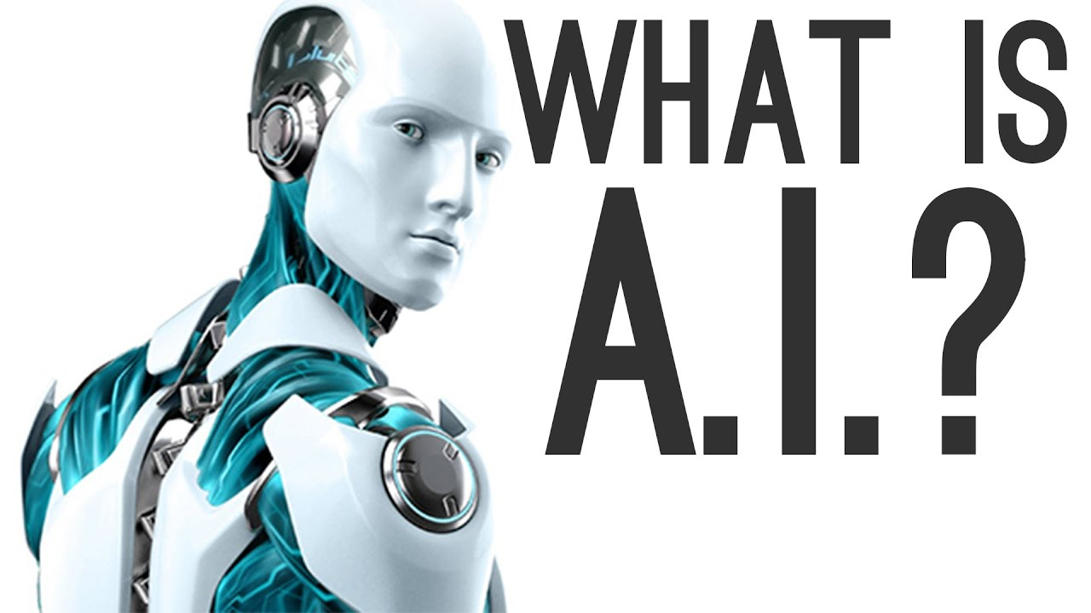
Introduction
Intelligence demonstrated
by machines

Slide 4

Introduction

Slide 5
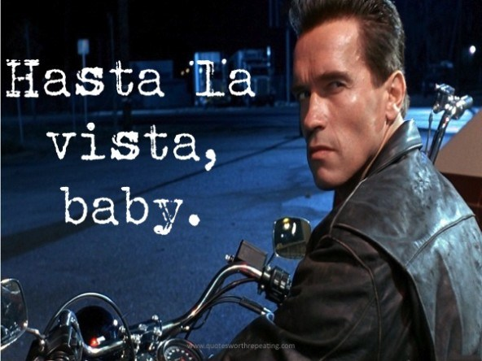
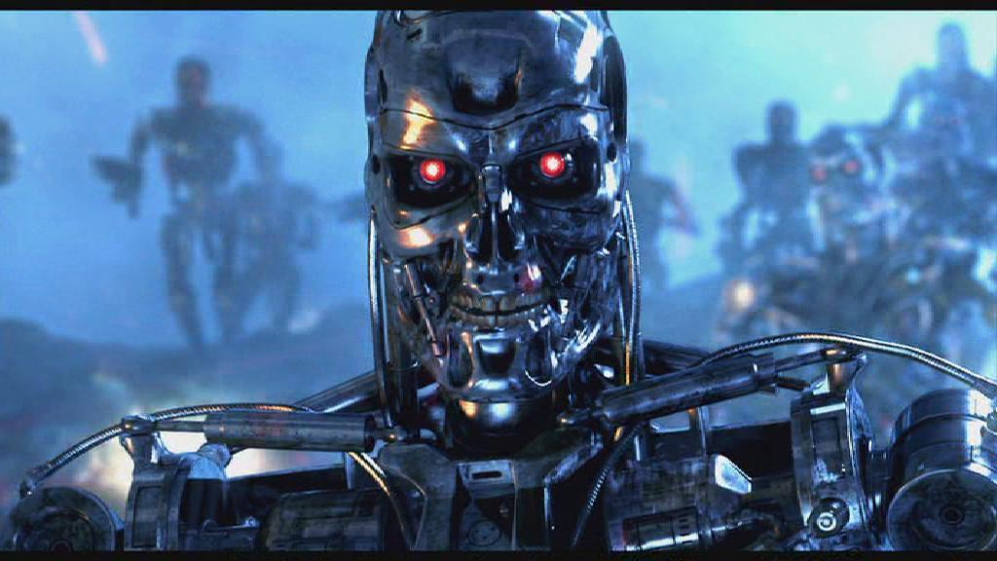
Introduction

Slide 6
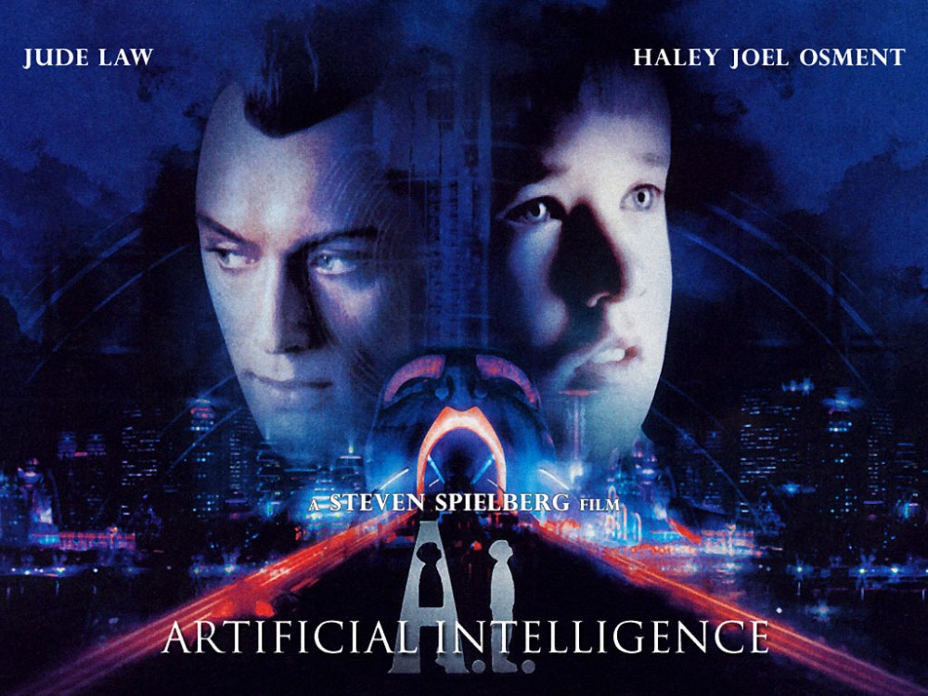
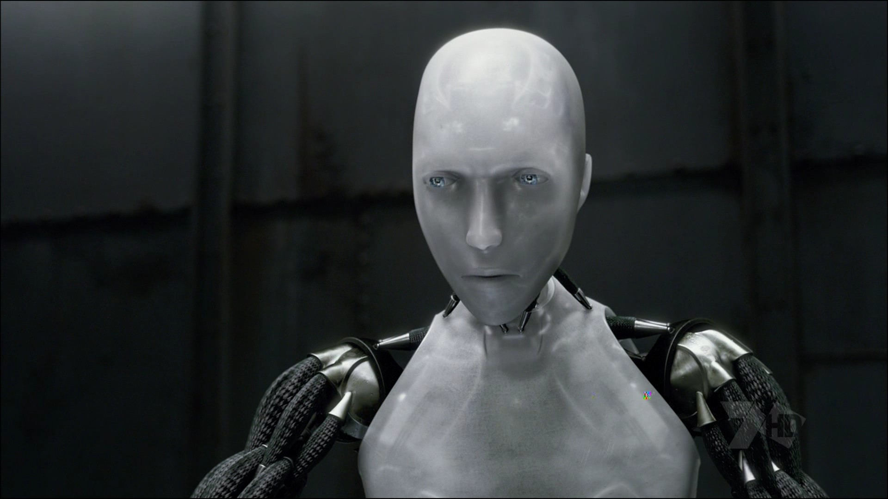
Introduction

Slide 7
What about AI in real life ?
Lets guess a few examples

Slide 8
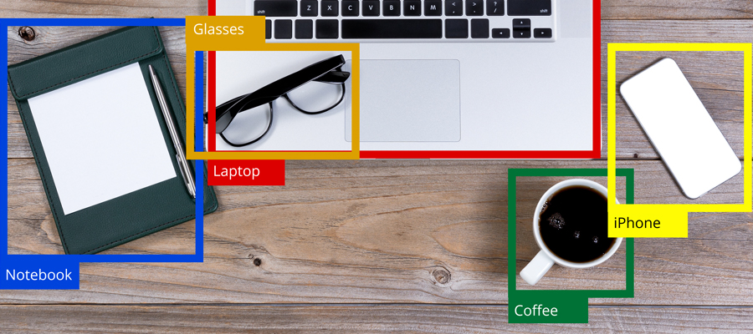
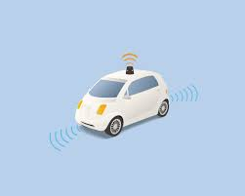
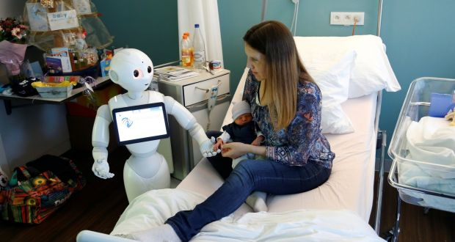


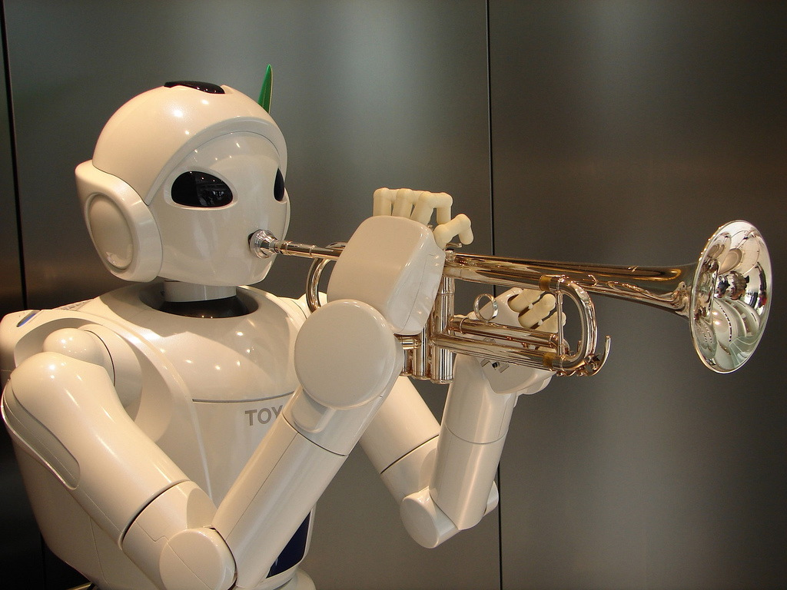




Slide 9
A BRIEF HISTORY OF AI

Slide 10
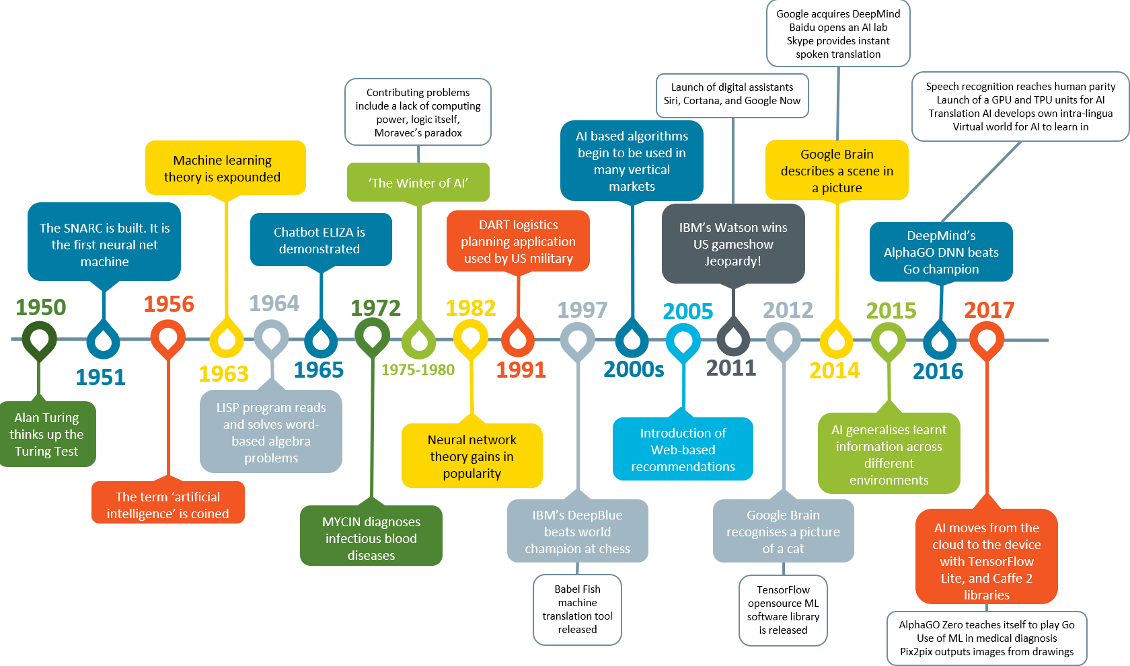

Slide 11
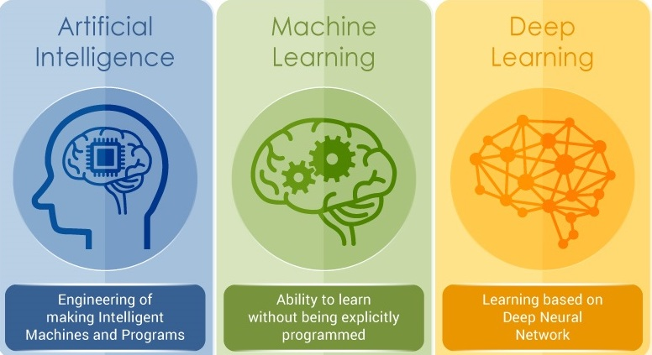
AI, ML, DL, RL and Big Data

Slide 12
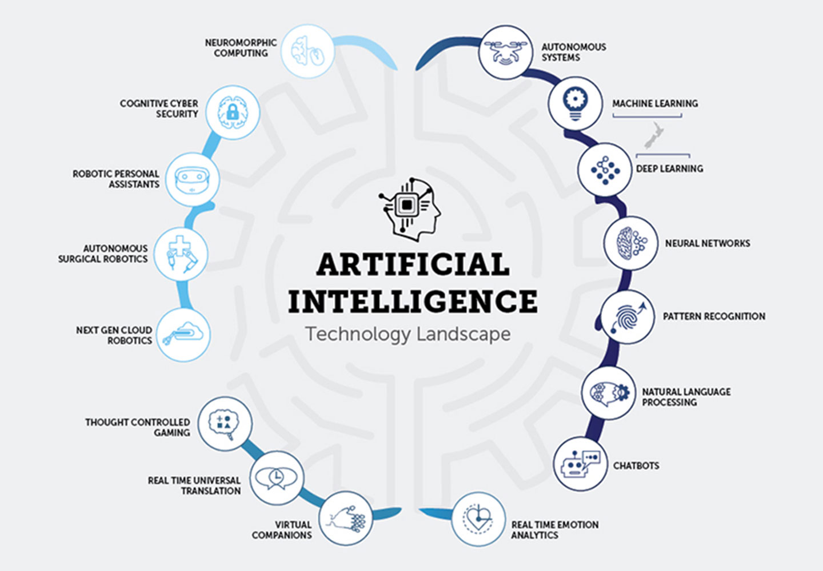
WHAT
IS
ARTIFICIAL
INTELLIGENCE ?

Slide 13
AI, ML, DL, RL and Big Data

Slide 14
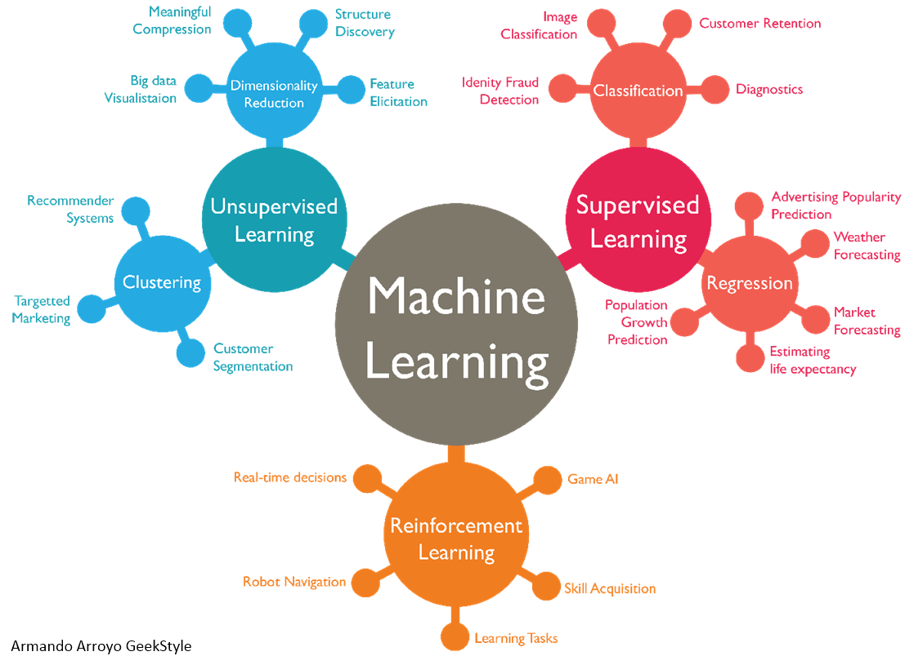





Slide 15
AI, ML, DL, RL and Big Data

Slide 16


Slide 17
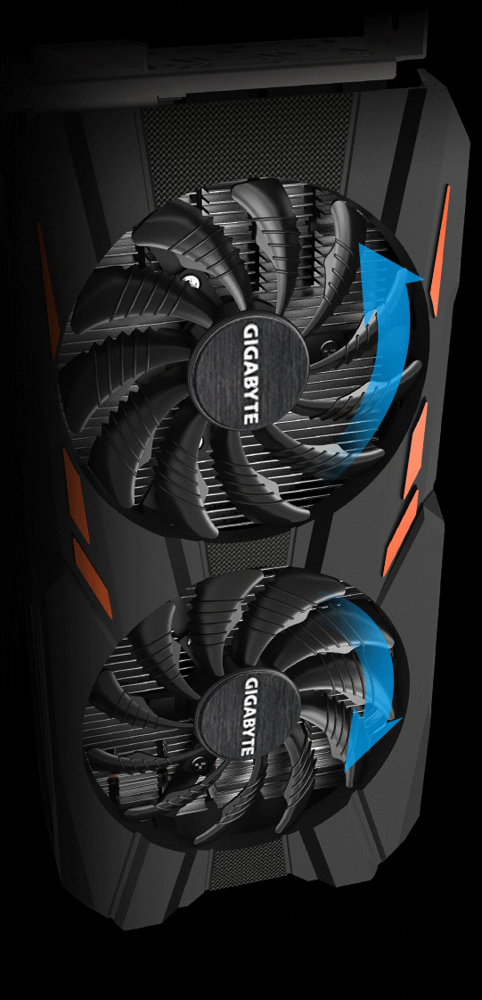

Slide 18

Agenda
Introduction
A brief History of AI
AI, ML, DL, RL and Big Data
Introduction to RL
How does RL work ?
AI Challenge

Slide 19
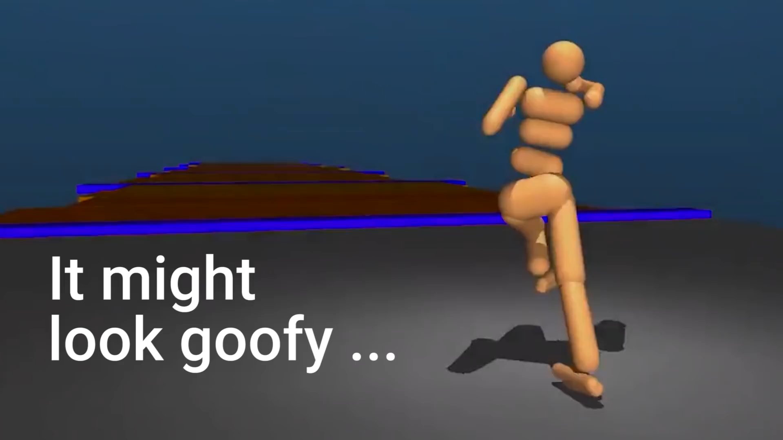
Humanoid learn to walk using RL

Slide 20
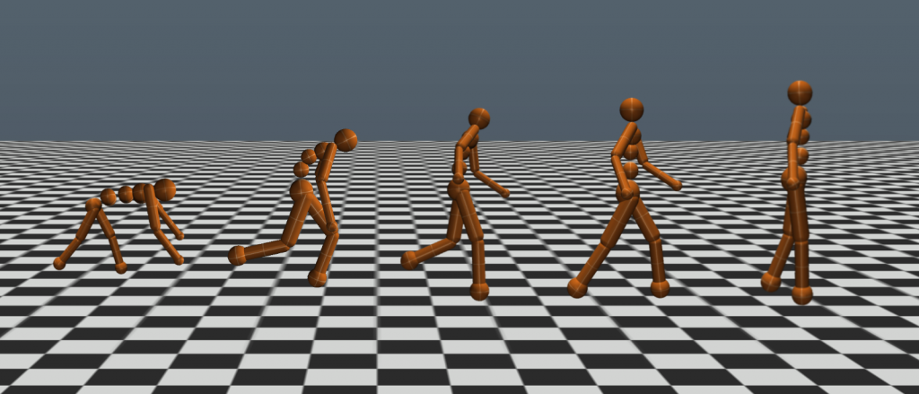
It all started with baby steps

Slide 21
HOW REINFORCEMENT LEARNING WORKS ?

Slide 22
Reinforcement Learning is nothing but learning from mistakes

Slide 23


Slide 24
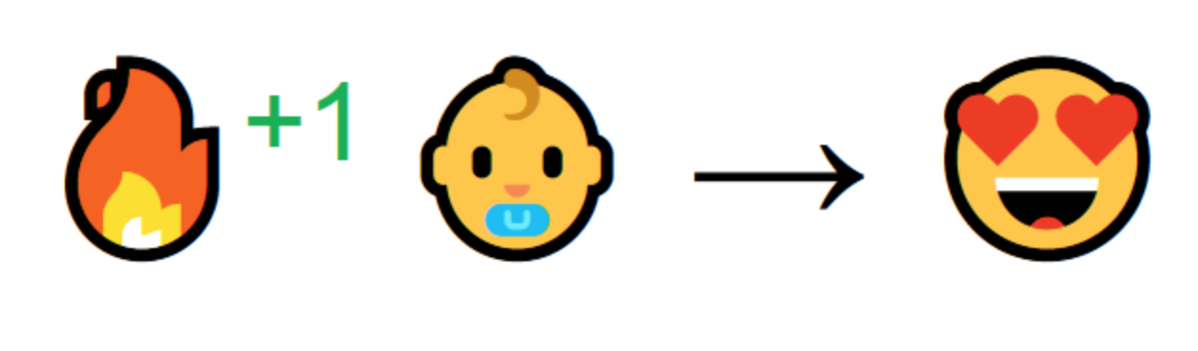

Slide 25


Slide 26
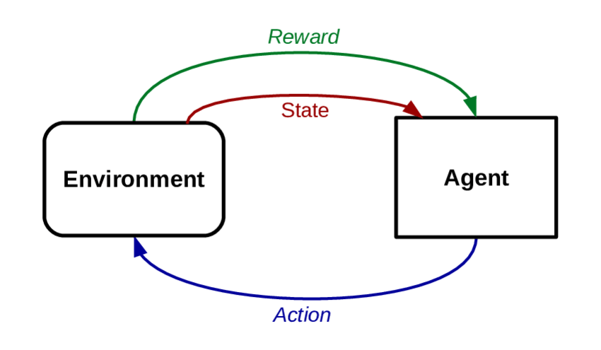
Introduction to Reinforcement Learning

Slide 27
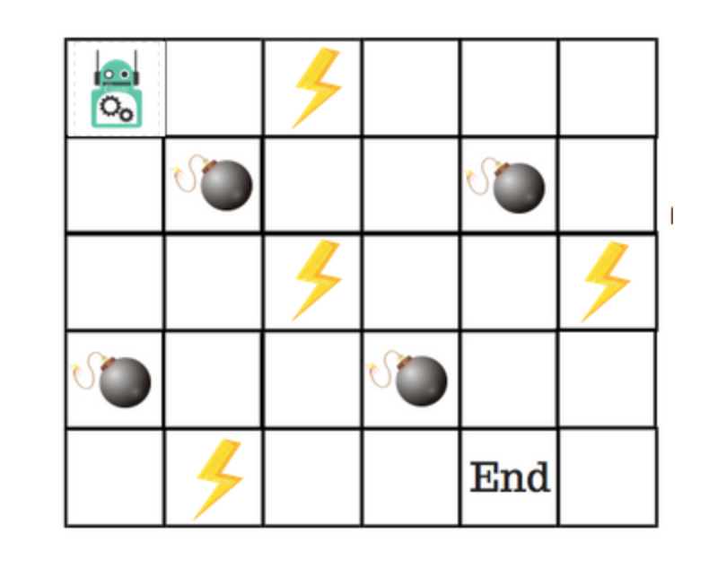
Q Learning
Goal : To reach the ”END”
Bomb: “GAME OVER”
Power up : ADDS one to life

Slide 28
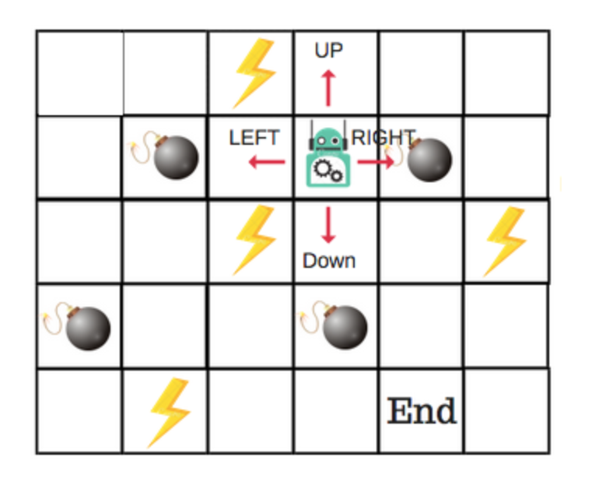
Q Learning
4 Actions
RULES:
START WITH 8 POINTS
LOSE A POINT EVERY STEP
BOMB: -100 POINTS
POWER: +1 POINT
END : +100 POINTS

Slide 29
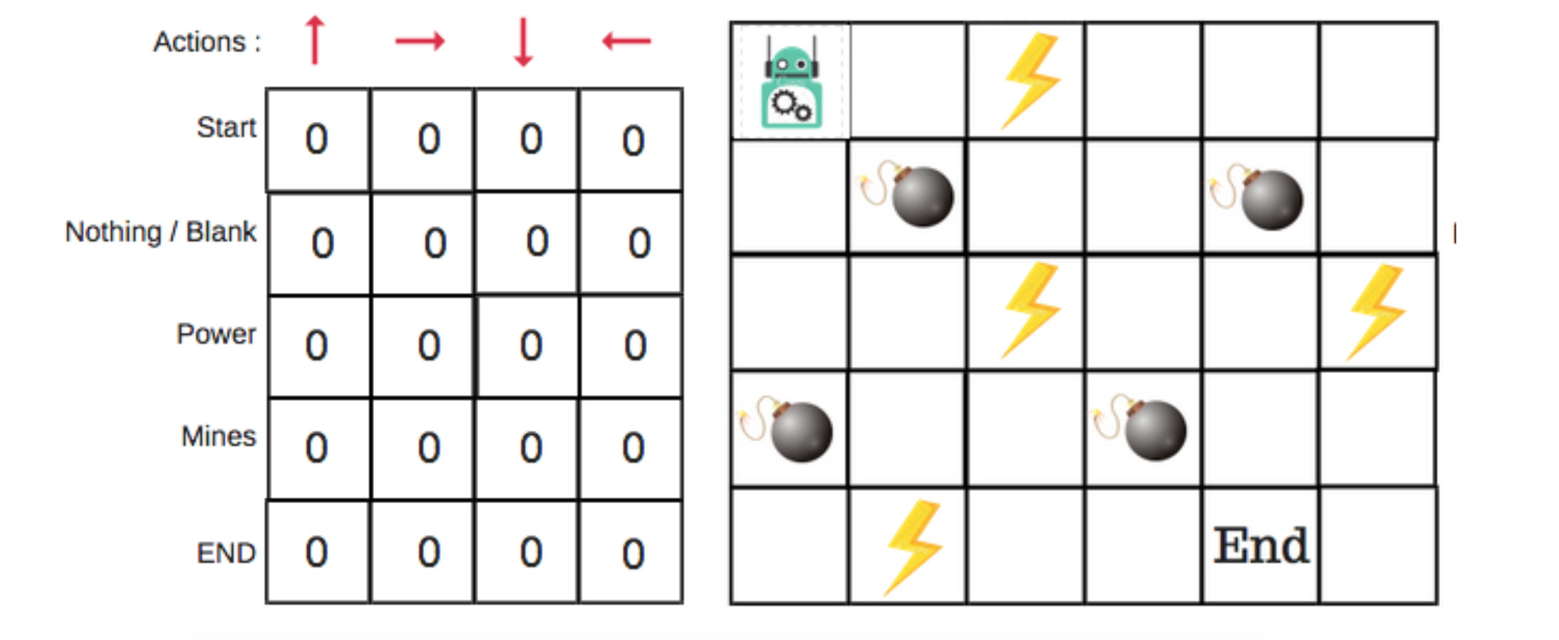

Slide 30
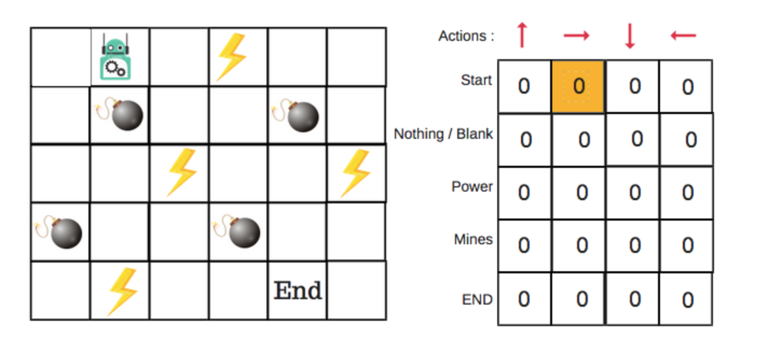
0.1

Slide 31

Bellman equation
Whoa! That’s bit complicated

Slide 32
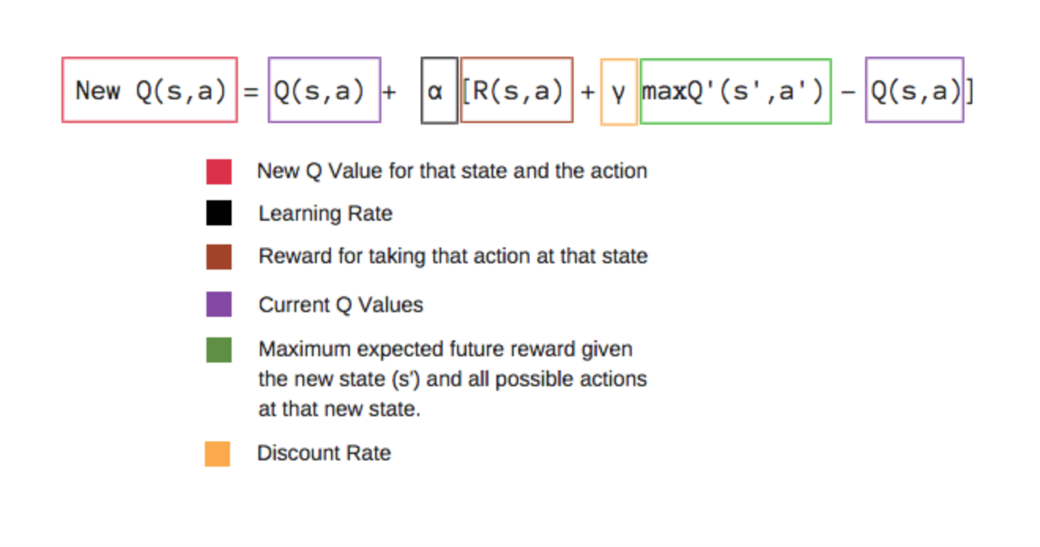
Bellman equation

Slide 33
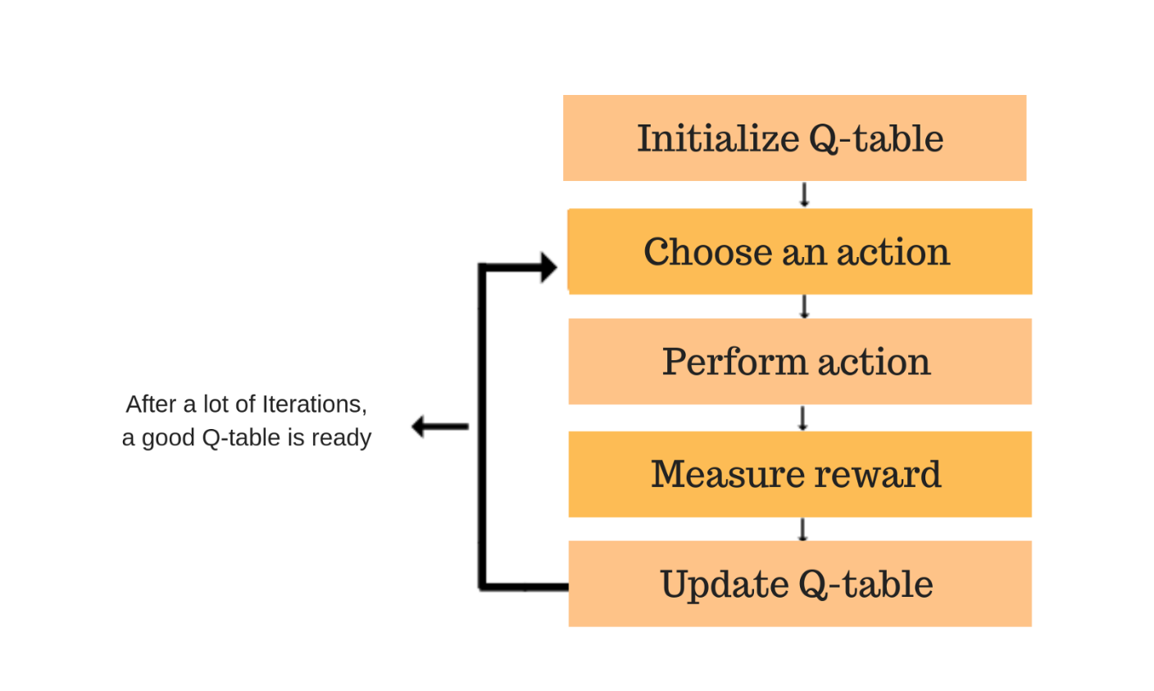
Q ALGORITHM

Slide 34



BIG PLAYERS IN RL

Slide 35
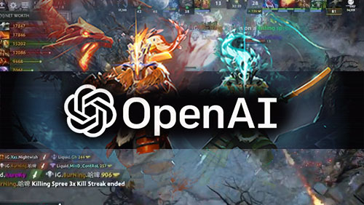
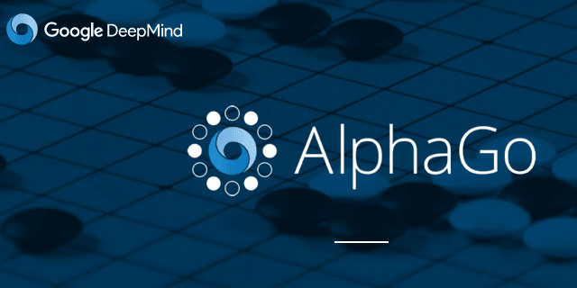

BIG PLAYERS IN RL

Slide 36
11 Billion Notional
Whoa! That’s a big number, aren’t you proud?

Slide 37
SO MANY ALGORITHMS OUT THERE
Q LEARNING
DOUBLE Q LEARNING
ADVANTAGE ACTOR CRITIC
RAINBOW RL
CURIOUSITY DRIVEN RL

Slide 38
Agenda
Introduction
A brief History of AI
AI, ML, DL, RL and Big Data
Introduction to RL
How does RL work ?
AI Challenge

Slide 39

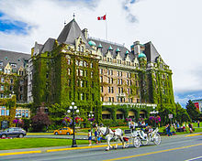
BATTLE SNAKE
AI CHALLENGE
March 2019, Victoria BC

Slide 40

BATTLE SNAKE AI CHALLENGE

Slide 41

CHOOSE YOUR ALGO
CHALLENGE
BUILD AN AI SNAKE USING ANY ALGORITHM
Min-Max
A* Search
Genetic Algorithm
Reinforcement Learning
Bread-First
Depth First
Beam Search
Evolutionary Algo
NO DATA
SCIENCE
NEEDED

Slide 42

THANKS!
Any questions?

Slide 43


I DO NOT OWN COPY RIGHT FOR ANY OF THE IMAGES ON THIS PRESENTATION.
ALL COPY RIGHTS BELONG TO PEOPLE WHO CREATED IT AND UPLOADED TO
THE INTERNET. SO PLEASE DON’T REPORT ME.

